Slide 1
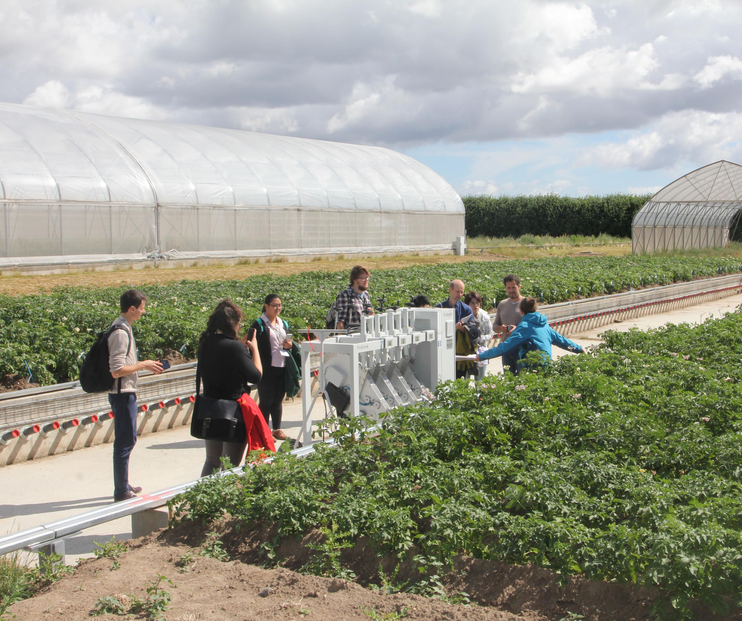
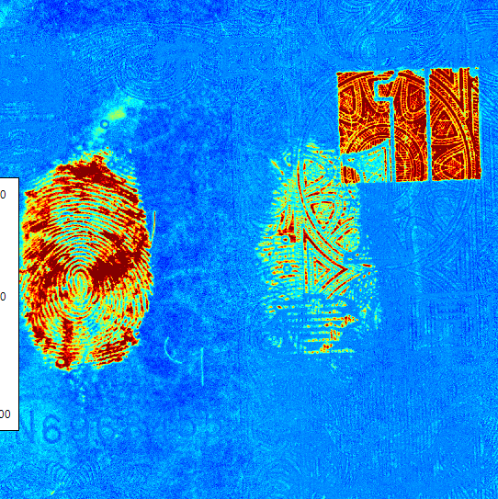
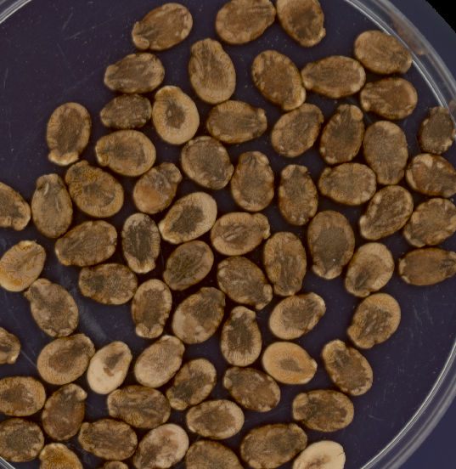
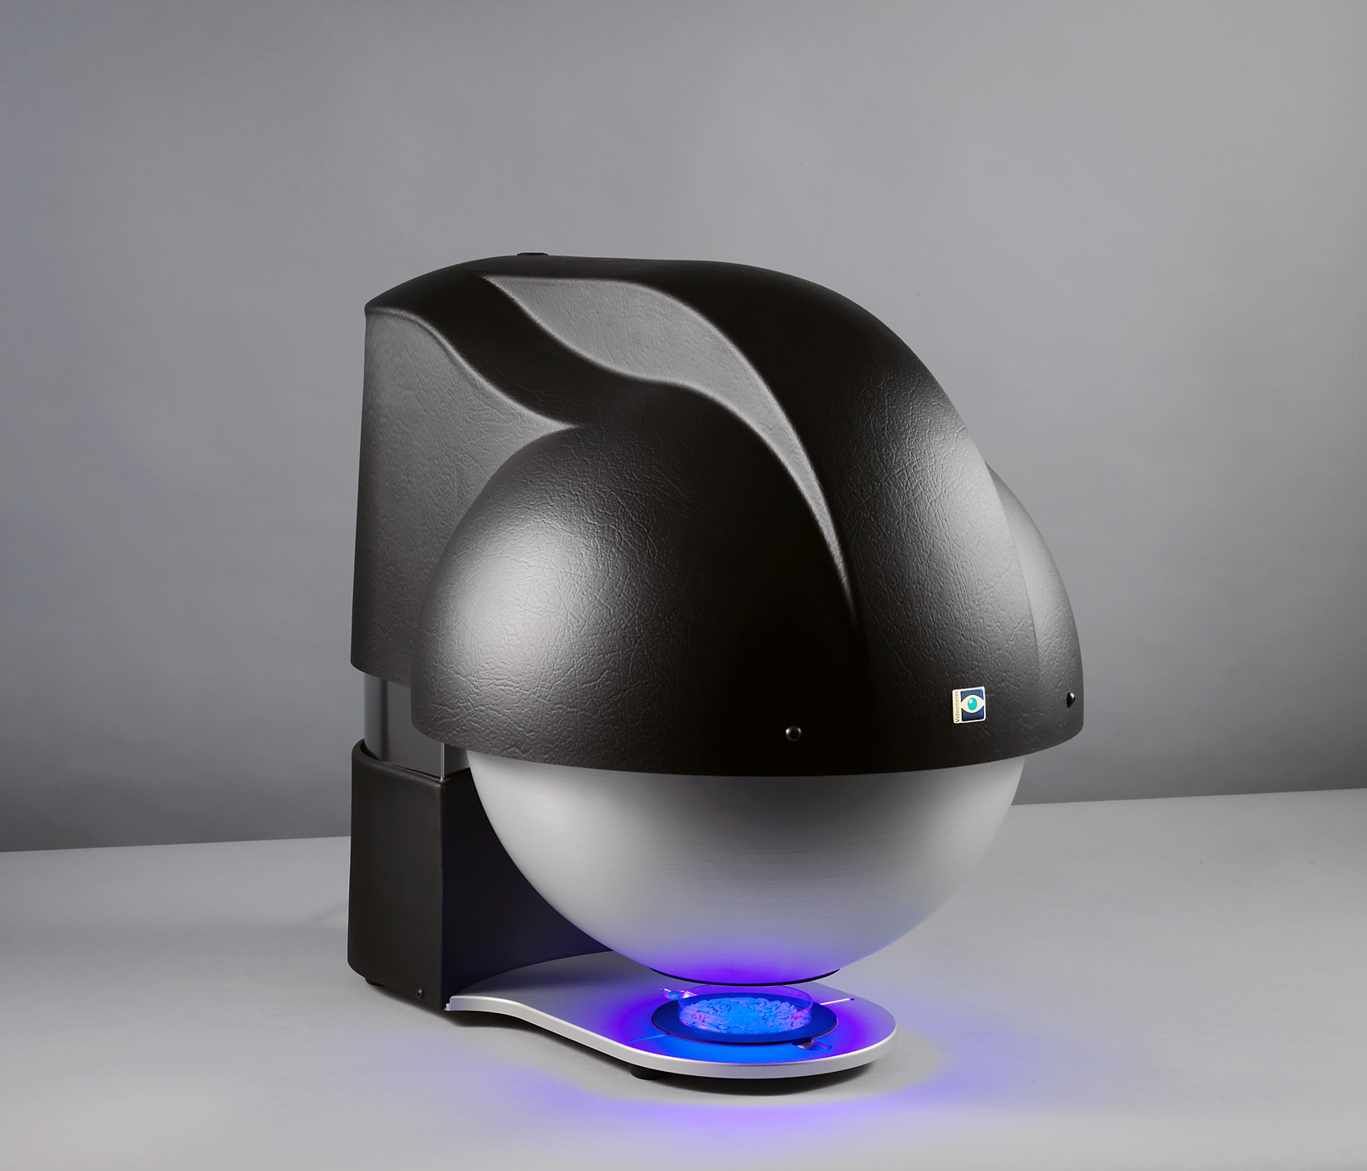
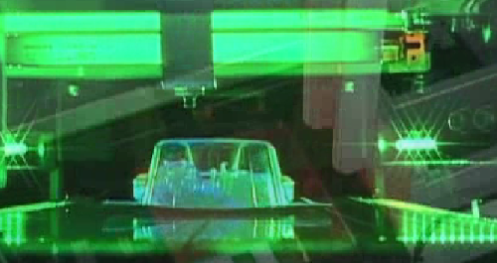
Videometer Blob Training 2020
Videometer A/S
Horkaer 12B, 3. floor
DK-2730 Herlev, Denmark
www.videometer.com
mail@videometer.com

Slide 2
Blob Tool Seminar
How to create and manage blob collections in Blob tool
How to develop classifiers in Blob tool
How to develop classifiers in Classifier Design Tool (CDT)
How to set up your own blob features
How to make classifiers that runs on the Autofeeder – scanning of data on the Autofeeder, develop classifier and run the classifier on the Autofeeder.

Slide 3
Blob Tool & CDT workshop schedule
09:00-09:15 Welcome & Introduction
09:15-09:45 Short introduction to MSI transformations & segmentations for granular products – Powerpoint presentation
09:45-10:00 Break
10:00-11:00 Walk-through Blob Tool with tutorial and examples on maize & barley
11:00-12:00 Walk-through Classifier Design Tool with tutorial and examples on pet-food & skinned barley
12:00-13:00 Lunch

Slide 4
Blob Tool & CDT workshop schedule
13:00-15:00 Hands-on work:
1) Scanning samples with Autofeeder
2) Make your own classifier for watermelon in Blob Tool
3) Make your own classifier for moldy wheat in CDT
4) Set up Autofeeder recipe & run classifier on Autofeeder
15:00-15:15 Break
15:15-16:30 Walk-through Blob feature tool-box with tutorial on the most important blob features.
16:30-17:00 Wrap up session with summary and next steps.

Slide 5
Blob Tool tutorial contents
Create blob collection from VideometerLab images
Labelling of blobs
Feature calculation & analysis
Report-tool and export of blob features
Generation of classifiers and applying classifiers on new blob collections.
Contents
of classifiers and applying classifiers on new blob collections.

Slide 6
CDT tutorial contents
Structure of Classification Models
Managing training & validation sets
Navigating between blobs & blob feature statistics plot
Introduction to logical rules and statistical rules
Building hierarchical classification models
Copying data between different classification models
Contents
of classifiers and applying classifiers on new blob collections.

